Slide 1
Open Source is the way forward for mainframe
John Mertic
Director, Open Mainframe Project
Notes:
In this talk, we will focus on how forward thinking enterprises leverage hybrid infrastructure rather than any one approach to their IT infrastructure. In the past several years, more and more organizations use their computing infrastructure as a strategic advantage; buying off the shelf they view is keeping them at the same level as their competitors, but leveraging computing infrastructure that solves their business problems specifically helps them be more efficient and better engage their customers.

Slide 2
Why Open Source for mainframe?
Notes:
The big question everyone both in the mainframe ecosystem and outside the mainframe ecosystem is - why open source for mainframe? Isn’t mainframe a closed, legacy platform?
That simply isn’t true - in fact we can trace the history of open source back to SHARE in 1955 with the early collaborations on users of the IBM 704 to share best practices, learnings, and even code with one another. Open source projects can trace back historically to CBT Tape, a project started in 1975 for collecting all the code shared over the previous two decades into a conical resource. Both SHARE and CBT Tape are still here and thriving to this day.
IBM z16 image used with permission by International Business Machines Corporation 2022

Slide 3
Why Open Source for mainframe?
Open Source accelerates innovation
Open Source is (more) secure
Notes:
There are two key reasons on why open source for mainframe - it accelerates innovation and is more secure.

Slide 4
Why Open Source for mainframe?
Open Source accelerates innovation
Open Source is (more) secure
Notes:
Let’s dig into why and how open source accelerates innovation

Slide 5
Open source is huge and universal
40M
420M
2T
Over 40 million OSS components available¹
OSS component releases available by 2026²
2 trillion package downloads a year³
^{1, 3} Sonatype, 2021 State of the Software Supply Chain
² Vercaode, The Busy Manager's Guide to Open Source Security
Notes:
Open source is continues to grow at a staggering rate as these key numbers tell us. This growth isn’t just tied to hobbists

Slide 6
10%
custom code
90%
of a modern application’s code base is open source¹
¹ Sonatype, 2020 and 2021 State of the Software Supply Chain
Notes:
98% of general codebases & of Android apps that contained OSS [Synopsys2021]
70% of codebase that was OSS on average [Synopsys2020]
90% of codebase was OSS on average [Sonatype 2020]
528: Average number of OSS libraries per analyzed codebase [Synopsys2021]
The top four open source
ecosystems released a
combined 6,302,733 new
versions and introduced
723,570 brand new
projects. Collectively,
these communities now
contain a combined
37,451,682 different
versions of components,
representing a 20% year
over year (YoY) growth
2.2
trillion open source packages
from these same four ecosystems,
representing a 73% YoY
growth

Slide 7
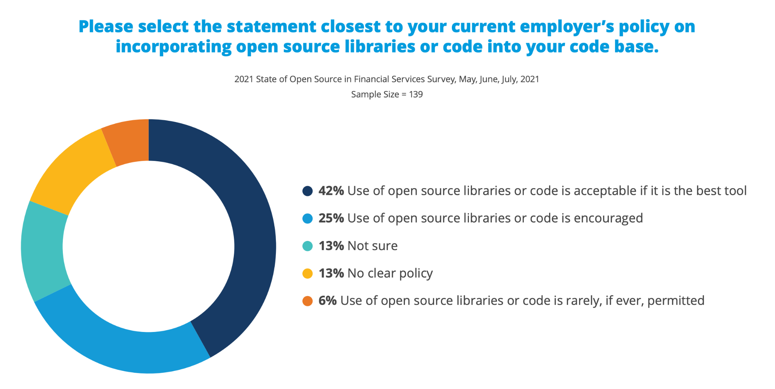
Your customers are already using open source!
Open source is prevalent in the financial services industry
These companies are developing centers of excellence ( open source program offices or OSPOs for using and contributing to open source.

Slide 8
Why Open Source for mainframe?
Open Source accelerates innovation
Open Source is (more) secure

Slide 9
Why is open source more secure?
Many more eyes are looking to find and fix problems.
Open source projects fix vulnerabilities and release patches and new versions a lot faster.
Practically all commercial software uses a healthy chunk of open source, but in many cases it is not appropriately managed.
Source: https://www.whitesourcesoftware.com/resources/blog/3-reasons-why-open-source-is-safer-than-commercial-software/

Slide 10

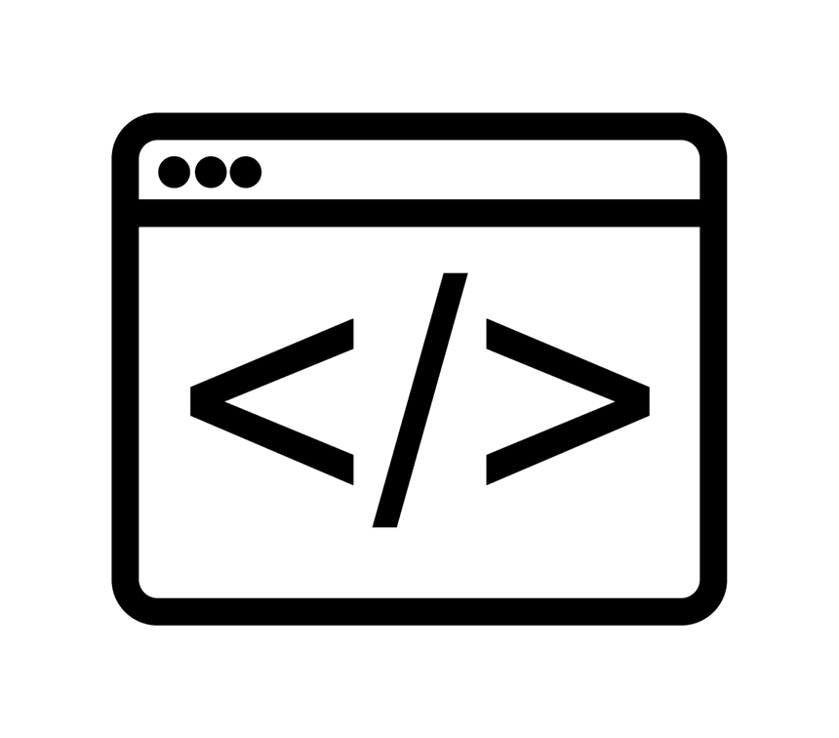

Open Source has a strong and healthy security Community
1
4
10
11
14
2
3
5
6
7
Source
Build
Package
8
9
19
13
16
12
15
18
21
22
Developer
Consumer
17
Dependencies
1. OpenSSF: find, inform, automate, fix, and educate
2. SPDX (ISO 5962): international standard for Software Bill of Materials
3. CNCF: guide for supporting software supply chain best practices
4. Best Practices badge: Core Infrastructure Initiative (CII) Best Practices badge signifies code quality and security
5. SSDF: Secure Software Development Fundamentals set courses
6. Let’s Encrypt: the world’s largest certificate authority for the https:// protocol
7. CCC: Confidential Computing Consortium protects data in use in memory
8. CHAOSS: Community Health Analytics Open Source Software creates analytics and metrics for OSS that define health and identify risk
9. Harvard Research Partnership: Laboratory for Innovation Science at Harvard co-developed the report Vulnerabilities in the Core,’ a Preliminary Report and Census II of Open Source Software
10. in-toto: a framework designed to secure the integrity of software supply chains.
11. TUF: The Update Framework maintains the security of software update systems
12. Uptane: protects software updates delivered over-the-air to automobiles.
13. sigstore: eases the adoption of cryptographic software signing (of artifacts such as release files and container images) backed by tamper-resistant public logs (now in OpenSSF)
14. Git: Extending git to enable pluggable support for signatures
15. patatt tool: end-to-end cryptographic attestation to patches sent via email
16. OpenChain (ISO 5230): international standard for open source component tracking through supply chain
17. LFX: identify OSS vulnerabilities and code secrets, powered by Snyk and BluBracket
18. Tern: software composition analysis tool and library to generates a layer-by-layer view of what’s included within a container image
19. SBOM Generator: automatically generate a SBOM from your CI/CD system
20. CatchIT: CI/CD plug-in identifying confidential or sensitive information in code, and catch security violations
21. osquery: performant endpoint visibility
21. CASE Ontology: An international standard supporting automated combination, validation, and analysis of cyber-investigation information
Notes:
SPDX - new ISO standard for Software Bill of Materials
CNCF has also produced a guide for supporting software supply chain best practices
The OpenSSF’s Best Practices badge project
Secure Software Development Fundamentals set of courses
Let’s Encrypt is the world’s largest certificate authority for TLS certificates - Encryption in transit is implemented on the web using the TLS (“https://”) protocol
LF Confidential Computing Consortium is dedicated to defining and accelerating the adoption of confidential computing. Confidential computing protects data in use (not just at rest and in transit) by performing computation in a hardware-based Trusted Execution Environment.
Community Health Analytics Open Source Software (CHAOSS) focuses on creating analytics and metrics to help define community health and identify risk
n-toto is a framework specifically designed to secure the integrity of software supply chains.
The Update Framework (TUF) helps developers maintain the security of software update systems, and is used in production by various tech companies and open source organizations.
Uptane is a variant of TUF; it’s an open and secure software update system design which protects software delivered over-the-air to the computerized units of automobiles.
sigstore is a project to provide a public good / non-profit service to improve the open source software supply chain by easing the adoption of cryptographic software signing (of artifacts such as release files and container images) backed by transparency log technologies (which provide a tamper-resistant public log).
We are also funding focused work on tools to ease signature and verify origins, e.g., we’re working to extend git to enable pluggable support for signatures, and the patatt tool provides an easy way to provide end-to-end cryptographic attestation to patches sent via email.
OpenChain (ISO 5230) is the International Standard for open source license compliance. Application of OpenChain requires identification of OSS components. While OpenChain by itself focuses more on licenses, that identification is easily reused to analyze other aspects of those components once they’re identified (for example, to look for known vulnerabilities).
Linux Foundation and the Laboratory for Innovation Science at Harvard (LISH) developed the report Vulnerabilities in the Core,’ a Preliminary Report and Census II of Open Source Software, which analyzed the use of OSS to help identify critical software. The LF and LISH are in the process of updating that report. The CII identified many important projects and assisted them, including OpenSSL (after Heartbleed), OpenSSH, GnuPG, Frama-C, and the OWASP Zed Attack Proxy (ZAP). The OpenSSF Securing Critical Projects Working Group has been working to better identify critical OSS projects and to focus resources on critical OSS projects that need help. There is already a first-cut list of such projects, along with efforts to fund such aid.

Slide 11
Challenge:
How can we grow and sustain open source on mainframe?

Slide 12
Enter Open Mainframe Project
Open Mainframe Project believes…
that leading organizations leverage their technology infrastructure as a competitive advantage.
that the mainframe design principles of security, stability, scalability, and performance are important to these leading organizations
having the mainframe interoperable in a hybrid infrastructure enables leading organizations to realizes it’s benefits.
technical advancements that are needed by the mainframe community can be better achieved through open source.
Notes:
Open Mainframe Project was founded in 2015 to be the focal point for the growth of open source on mainframe.
Take a look at the Open Mainframe Project’s principles.
The project believes that interconnected mainframe happens through open source, and achieving this is only possible as a community effort.

Slide 13


Open Mainframe Project builds sustainable open source
Successful projects depend on members, developers, standards and infrastructure to develop products that the market will adopt.
PROJECTS
DEVELOPER
COMMUNITY
TECHNOLOGY
PARTICIPATION
MARKETS
PRODUCTS
PROFITS
PRODUCTS
Notes:
But most importantly, this is done sustainably. This means that the projects and working groups are structured and governed to drive forward for decades to come, using the same formula for success we’ve seen in over 450 open source projects hosted at the Linux Foundation.
(explain chart)

Slide 14
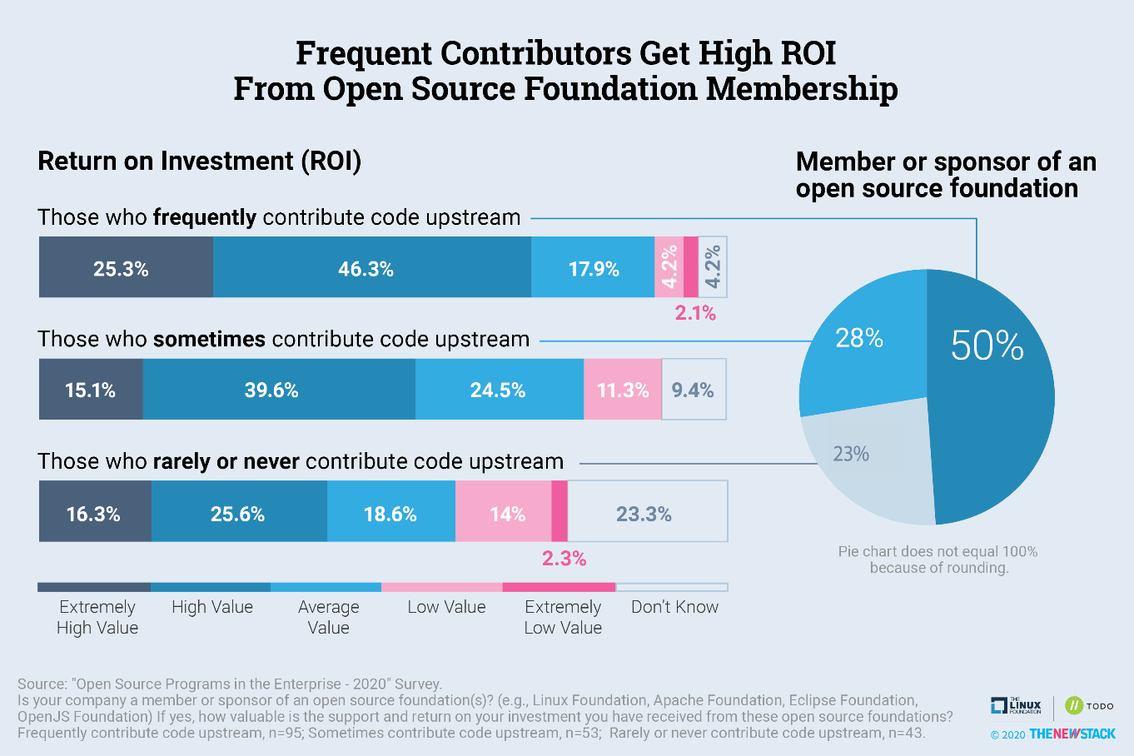

Slide 15





Vision
The mainframe is an active, integrated, and essential part of modern enterprise IT, consumable by mainstream developers and users, and driven by a vibrant open source community.
Mission
To achieve the vision of the Open Mainframe Project by…
Setting a high bar for application development on the mainframe
through documentation, API development, and a security-first approach.
Showcase the mainframe of today
to both the mainframe ecosystem as well as the broad enterprise IT community.
Enable the mainframe to be more consumable by developers
with a transparent experience in leveraging the value propositions of the mainframe.
Ensure the mainframe aligns well in the changing enterprise IT landscape
of cloud-native and DevOps.
Notes:
The mission of the Open Mainframe Project is to build that community and adoption of Open Source on the mainframe, which will ( read points above )
Image from https://www.openmainframeproject.org/about

Slide 16
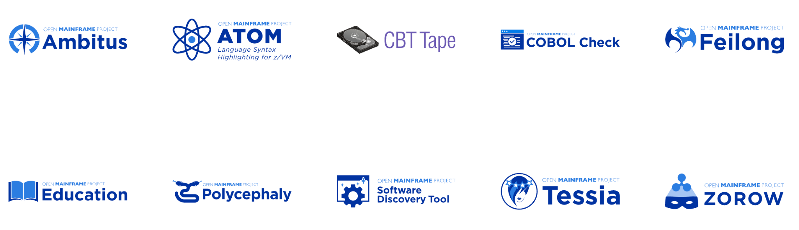
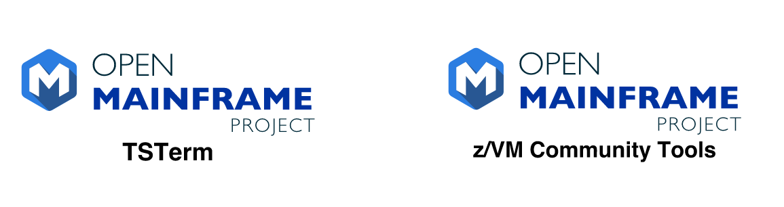
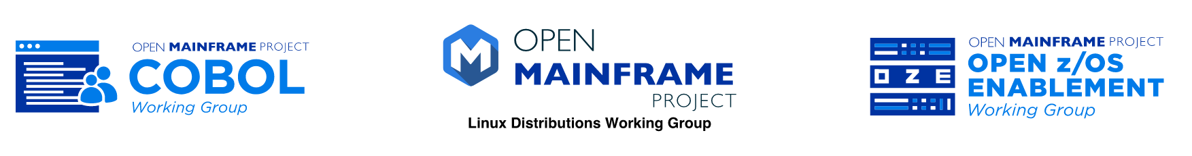
Open Mainframe Project enables this innovation
Active
Incubation
Sandbox
Working Groups
Learn about all Open Mainframe projects at https://www.openmainframeproject.org/projects
Notes:
Open Mainframe Project enables this innovation as a host of 18 projects and working groups that are part of closing the gap.
Source: https://landscape.openmainframeproject.org/pages/hosted-projects

Slide 17

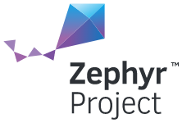

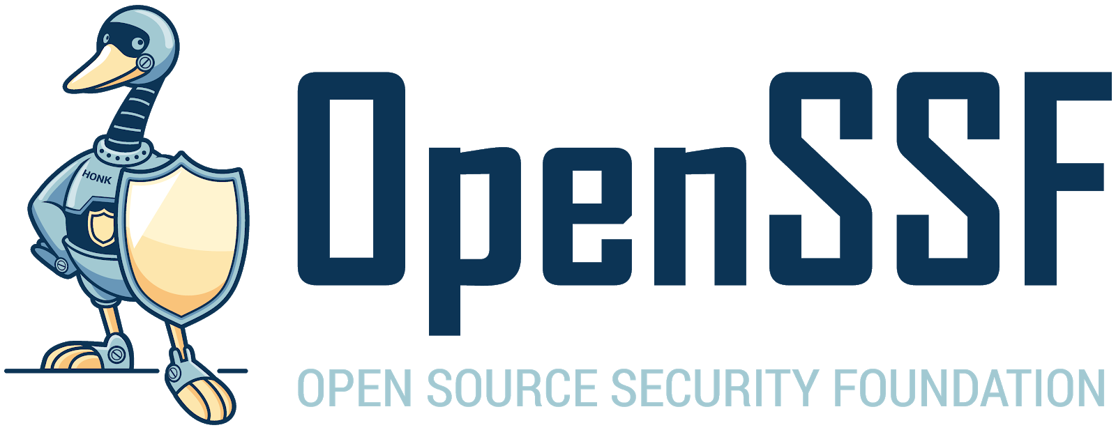


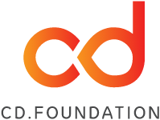



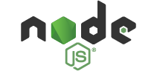
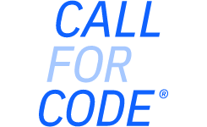


Open Mainframe Project: part of The Linux Foundation ecosystem of sustainable open source
For the last 16 years, The Linux Foundation has provided unparalleled support for open source communities through financial and intellectual resources, governance structure, IT infrastructure, services, events, and training.
Dedicated to building sustainable ecosystems around open source projects, The Linux Foundation is working with the global technology community to solve the world’s hardest problems through open source and creating the largest shared technology investment in history.
The Linux Foundation is the umbrella organization for more than 800 open source projects accelerating open technology development and commercial adoption. Some of the game-changing initiatives hosted by The Linux Foundation include:
Notes:
See more details here: https://www.linuxfoundation.org/join/#benefits

Slide 18
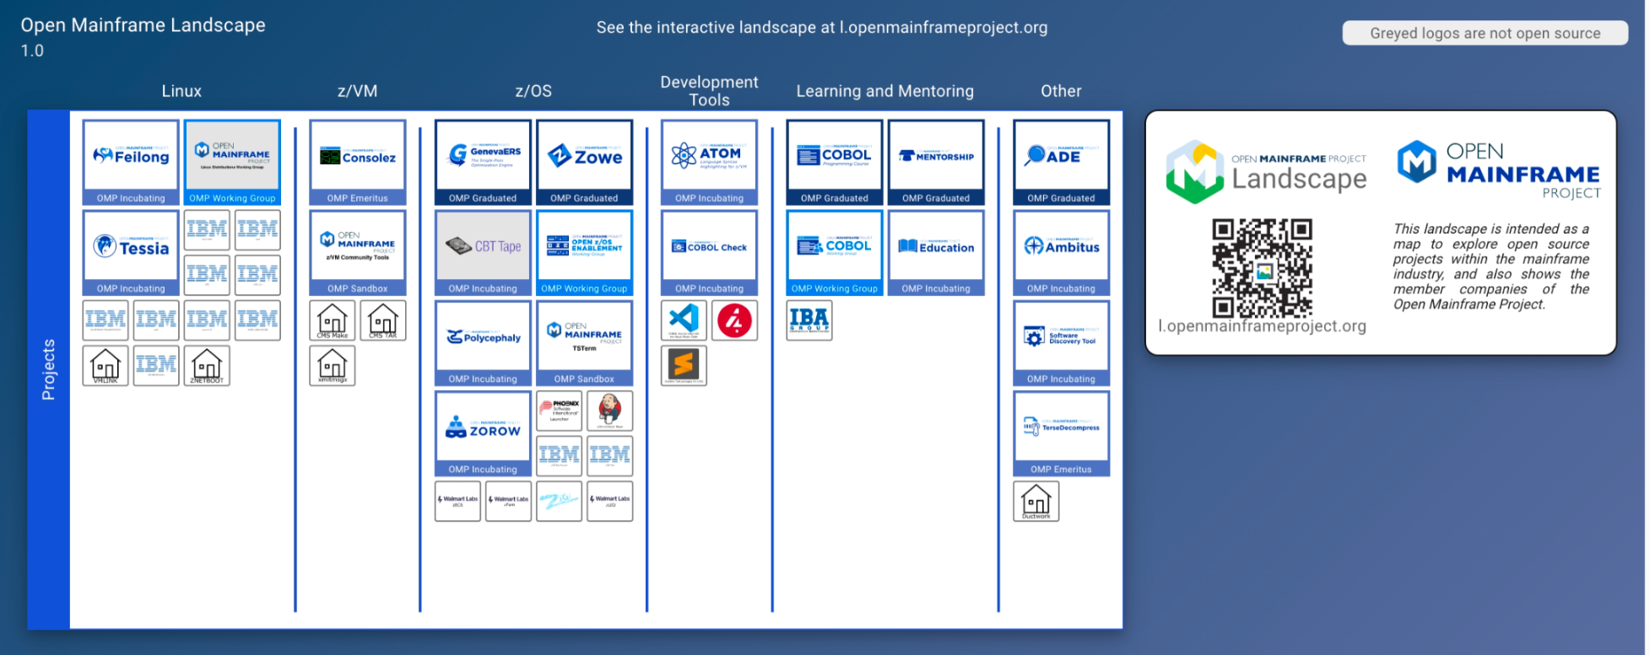
Landscape of open source projects only on mainframe
Source: https://landscape.openmainframeproject.org/fullscreen
Notes:
The ecosystem of open source on mainframe continues to grow, thanks to the work of the open source community on mainframe.
Source: https://landscape.openmainframeproject.org/fullscreen

Slide 19
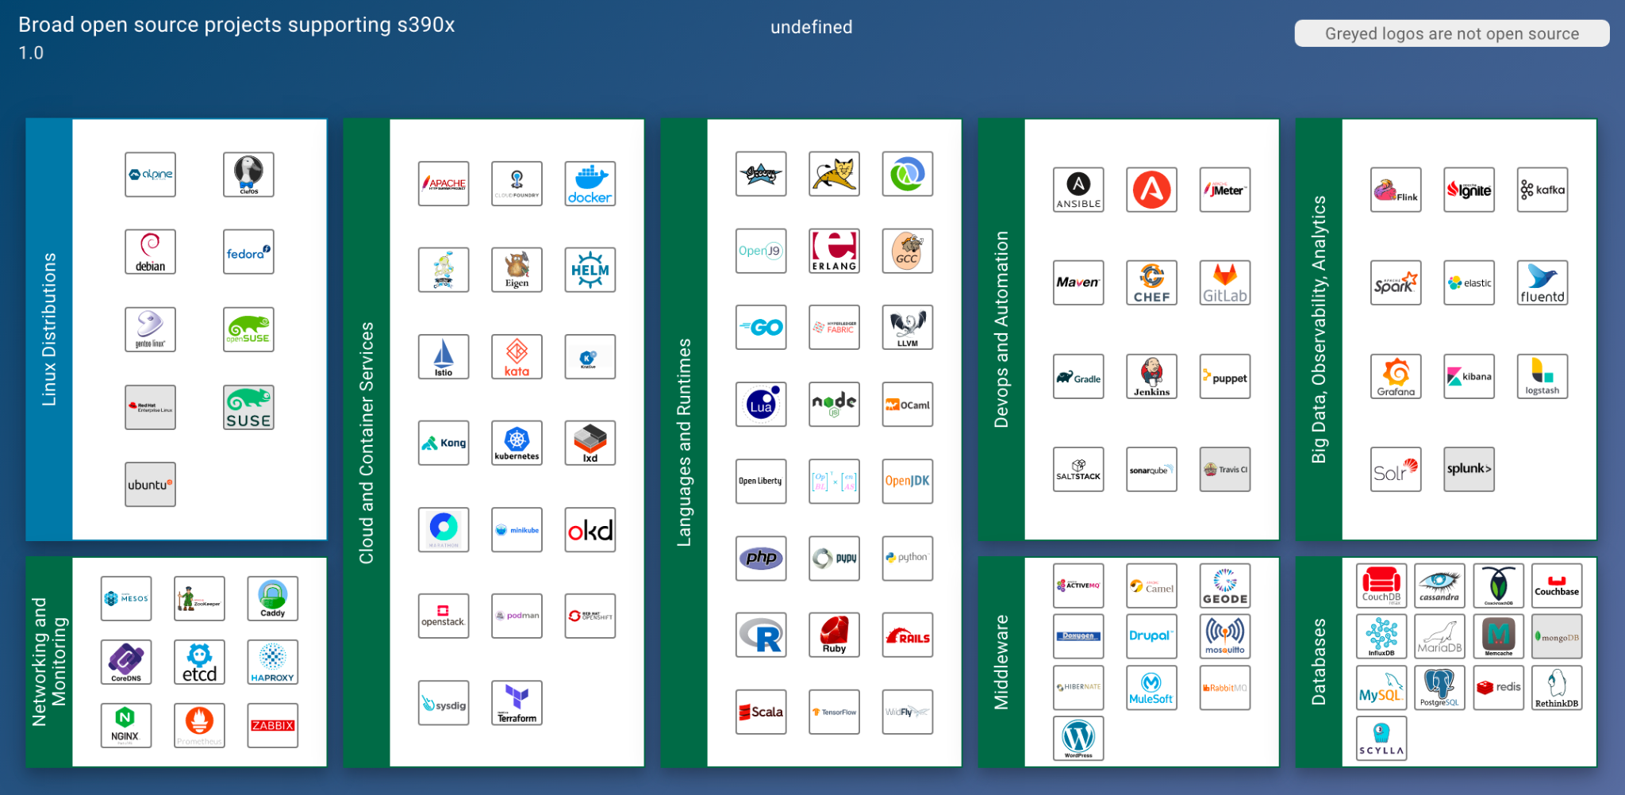
Broad open source supported on mainframe
Source: https://landscape.openmainframeproject.org/fullscreen/open-source
Notes:
Further, the open source community on mainframe is ensuring broad open source is supported on mainframe, which is the key piece for forward thinking organizations to realizing the mainframe’s benefits in their computing infrastructure.
Source: https://landscape.openmainframeproject.org/fullscreen/open-source

Slide 20

Enabling innovation - connecting z/OS to enterprise devops with Zowe
Modernize integration with z/OS based applications and services
Bridge the talent gap by enabling modern development stacks on z/OS
2018 Open Mainframe Project added Zowe from contributions from Broadcom, IBM, Rocket Software
2019 Zowe reached 1.0, launched Zowe Conformant to enable downstream ecosystem
Investments in collaboration, ecosystem development, and infrastructure
2021 Zowe formed TSC to have technologists lead project direction; launched Zowe Support Conformant Program
2022 Zowe 2.0 release
30000+ Commits, 250+ committers all time
Zowe gaining significant mindshare in DevOps community
50+ Zowe Conformant offerings from vendors including ASG, BMC, Broadcom, IBM, MicroFocus, Phoenix Software International, Rocket Software
2 Zowe Conformant Support Providers - Broadcom and IBM
New project contributions from BMC, IBA Group, Vicom Infinity, and others, has grown codebase
Notes:
Let’s see how this is happening today. Enter Zowe, the first open source project launched on z/OS.
Zowe is focused modernizing integration with z/OS based applications and services, and at the same time bridging both the talent and tooling gaps. Launched in 2018, Zowe is gaining mindshare in DevOps and being leveraged by forward thinking organizations globally, shifting the perception of mainframe from a “legacy” platform to a “growth” platform.

Slide 21
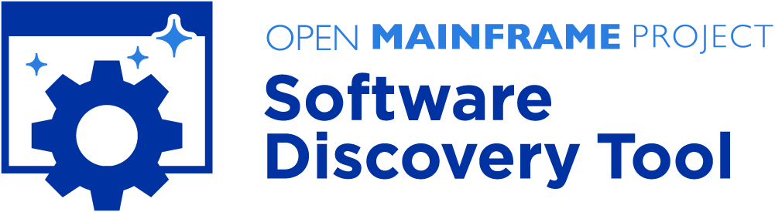

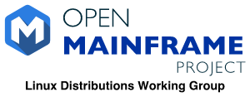
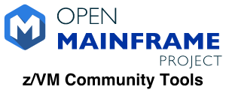

Enabling innovation - create hub for Linux on Z and z/VM community
Users want to manage their mainframes with the same modern cloud technologies used across the enterprise.
z/VM integration with technologies such as OpenStack have long been a challenge.
Contribution base was IBM only, making it challenging to get wider adoption
z/VM lacked a sustainable hub for community tools and utilities
Linux distributions supporting s390x mainframe
2019 Open Mainframe Project added Feilong
2020 Software Discovery Tool and Tessia added as a projects
2021 z/VM Community Tools forms as a Sandbox project, Linux Distributions Working Group formed
Central repository for open source on mainframe developed, tracking across all major distributions ( http://sdt.openmainframeproject.org )
Sustainable and coordinated maintainership for s390x Linux distributions, including Debian, Fedora, and openSUSE amongst others.
Central hub being developed for z/VM tools and utilities for easier discoverability.
Notes:
Linux has been part of the mainframe since 1999, which has enabled more and more workloads to shift to mainframe. While from a developer perspective, Linux on mainframe is just like Linux anywhere, there are key technologies such as z/VM which are native to the platform and key to having a unified DevOps approach.
These three projects, ConsoleZ, Feilong, and Tessia, all touch on parts of that story. In the past efforts like this had been driven within IBM, but with the launch of the Open Mainframe Project IBM and the community now have a space for collaborating with customers and vendors to drive an open source solution. In addition, all being a part of the Open Mainframe Project enables closer cooperation between projects.

Slide 22



Enabling innovation - modernizing COBOL
COBOL talent is critical to our society, and the need has amplified in the COVID-19 pandemic.
Enabling the next generation to have COBOL skills done in isolation, causing repeated efforts and lower uptick.
COBOL lacking tools that align with modern development
Launched COBOL Programming Course as an open source project in April 2020
Created collaboration forums and ways that COBOL talent can advertise their availability
Launched COBOL Working Group to bring together leaders in thinking about the future of COBOL
COBOL Check project launched, bringing TDD practices to COBOL
“Calling all COBOL Programmers” forum has had over 1800 individuals make themselves available since April 2020
COBOL Programming Course has 1.9k stars and 400+ forks, along with 17 contributors from several organizations.
COBOL Working Group getting broad feedback on the future direction of COBOL
COBOL Check a step forward in modern dev practices
Notes:
COBOL hit our collective awareness in the early days of the COVID-19 pandemic, and is identified as a key technology empowering our society. While COBOL was a modern language decades ago, with it being disconnected from other language communities and COBOL skills not being in focus in education, there was a need to move it forward.
Mainframe is where the vast majority of COBOL code is deployed, so the Open Mainframe Project became the natural home for creating a vendor-neutral space for this community. Open Mainframe Project focused on projects that help bring COBOL forward, from the COBOL Programming Course which was launched in the early days of the COVID-19 pandemic and has help hundreds learn COBOL using the development tools of today, to the COBOL Check project that is bringing TDD practices to COBOL development. In addition, thought leader is being driven in the COBOL working group that is aiming to continue pushing COBOL forward.

Slide 23

Enabling innovation - with the next generation
Aging tenured mainframe talent, with a growing mainframe talent gap and skills decline in next generation talent.
Needing to help connect students with opportunities in mainframe, aligning the interests in open source
Launched first mentorship program in 2016 with 7 mentees.
Connected within the mainframe and broad open source community to ensure mentorship work has upstream project value.
Enabled universities to also leverage the program within class work; successful with VCU and Western University (Ontario)
60+ mentees completed the program, with broader classwork focus reaching 100+ more.
Upstream work has included ports of Alpine Linux, contributions to HyperLedger, OpenStack, CloudFoundry, Kubernetes, and more.
Several mentees are now employed in mainframe roles with IBM, SUSE, ADP, and more.
Notes:
The mentorship program was started in 2016, and has brought an influx of students and new open source code into mainframe. It has also helped companies find talent, and academic institutions showcase talent to organization looking to hire.

Slide 24

Open Mainframe Project enables innovation through community building
Notes:
Code is not the only way innovation happens. Open Mainframe Project believes in community, and as part of it’s mission creates space and opportunity for that community to grow and thrive.

Slide 25
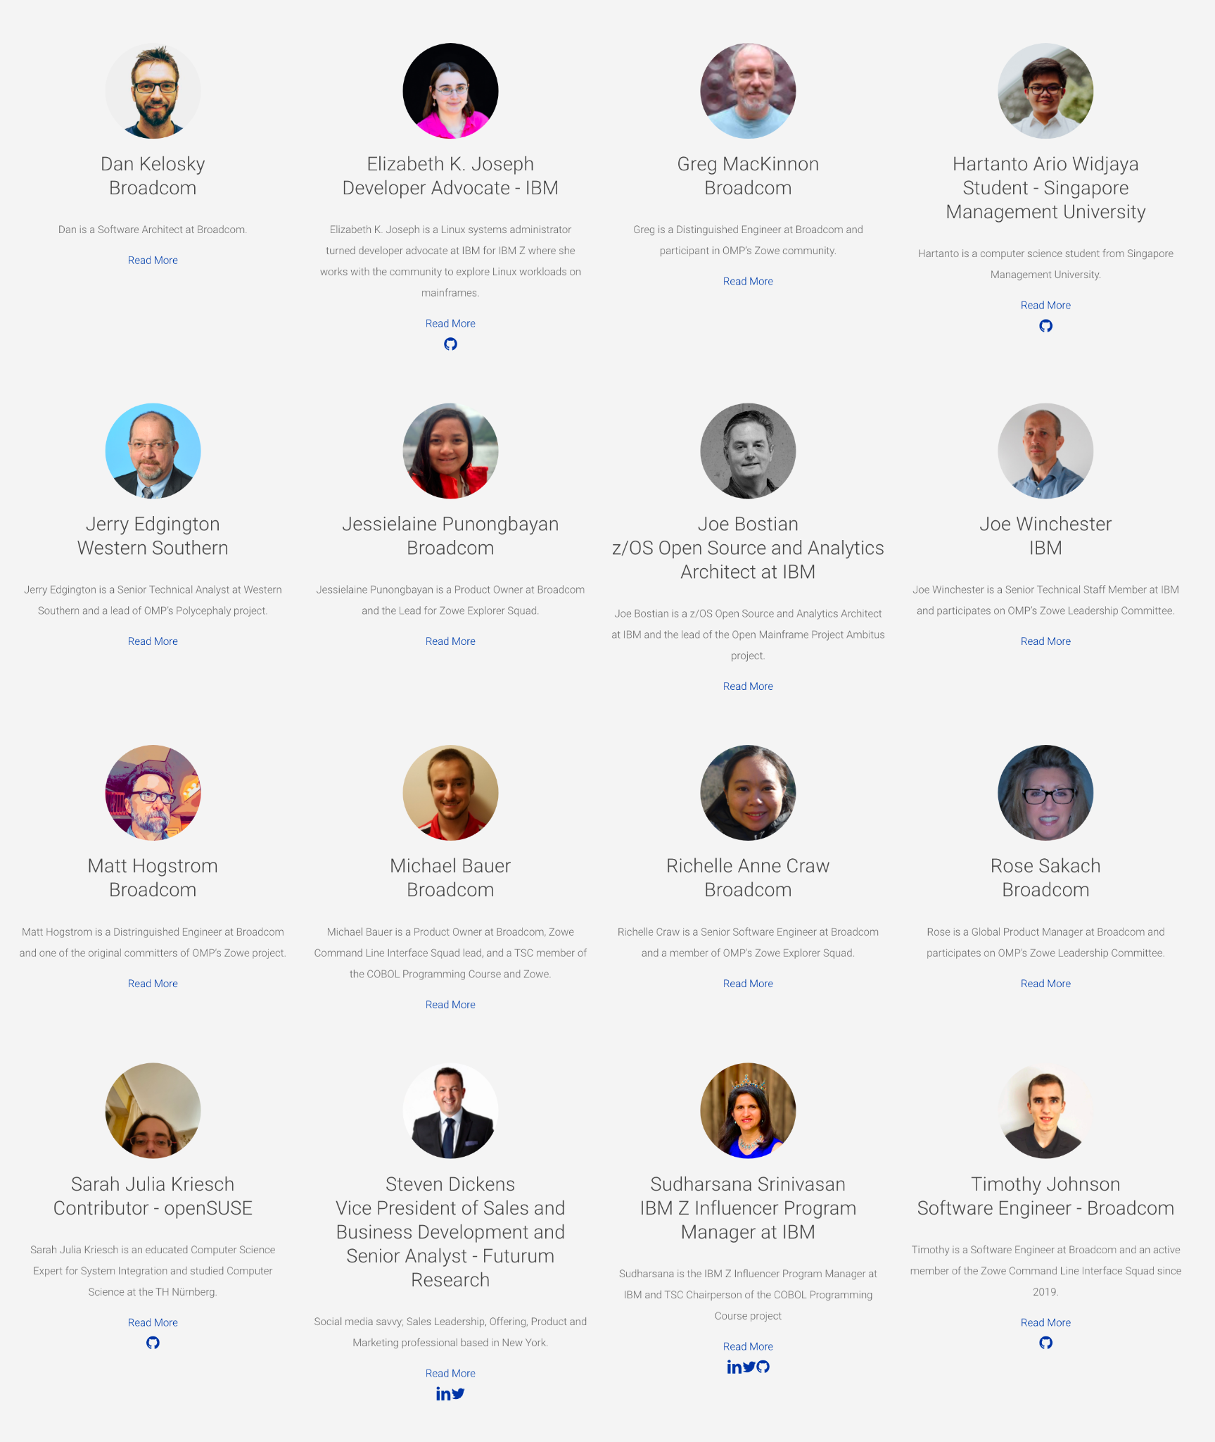
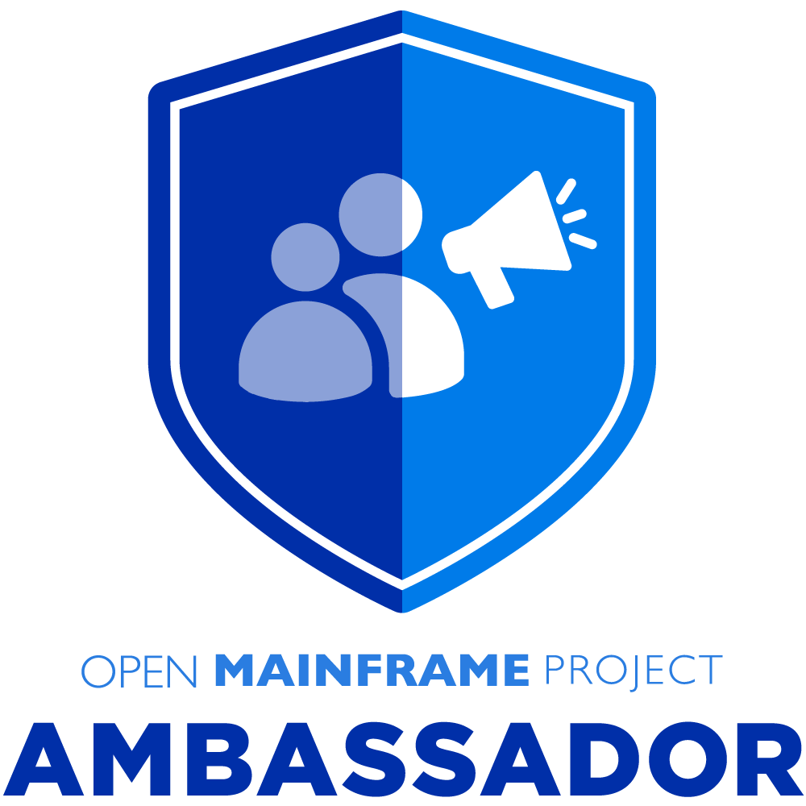
Meet the Open Mainframe Project Ambassadors
Open Mainframe Project Ambassadors are individuals who are passionate about the mainframe technology, recognized for their expertise, and willing to help others learn about it and community. Successful ambassadors are people such as bloggers, influencers, evangelists who are already engaged with an Open Mainframe project in some way including contributing to forums, online groups, community events, etc.
ACTION: If you would like an ambassador to speak at your event, please contact pr@openmainframeproject.org with the name of the conference, date and links.

Slide 26
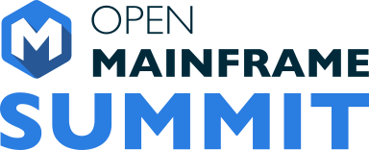
A Focal point for open source on mainframe
Open Mainframe Summit is the annual event that brings together the open source and mainframe ecosystems, discussing projects, trends, and executive insights.
September 21 – 22, 2022
Philadelphia, PA
https://events.linuxfoundation.org/open-mainframe-summit-2022

Slide 27
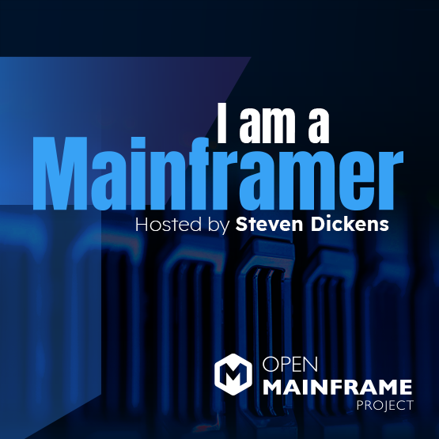



Telling the “mainframer” story
Monthly interview series that highlights diversity in mainframe
Showcases why people have mainframe in their careers and their views of the technology and career field
Read and listen at openmainframeproject.org/podcast
Notes:
One key way is through our podcast, “I Am A Mainframer”, which showcases those in this industry from all races, genders, ages, and locales, highlighting the diversity in mainframe and providing insight into where people in this community see the mainframe ecosystem going.

Slide 28

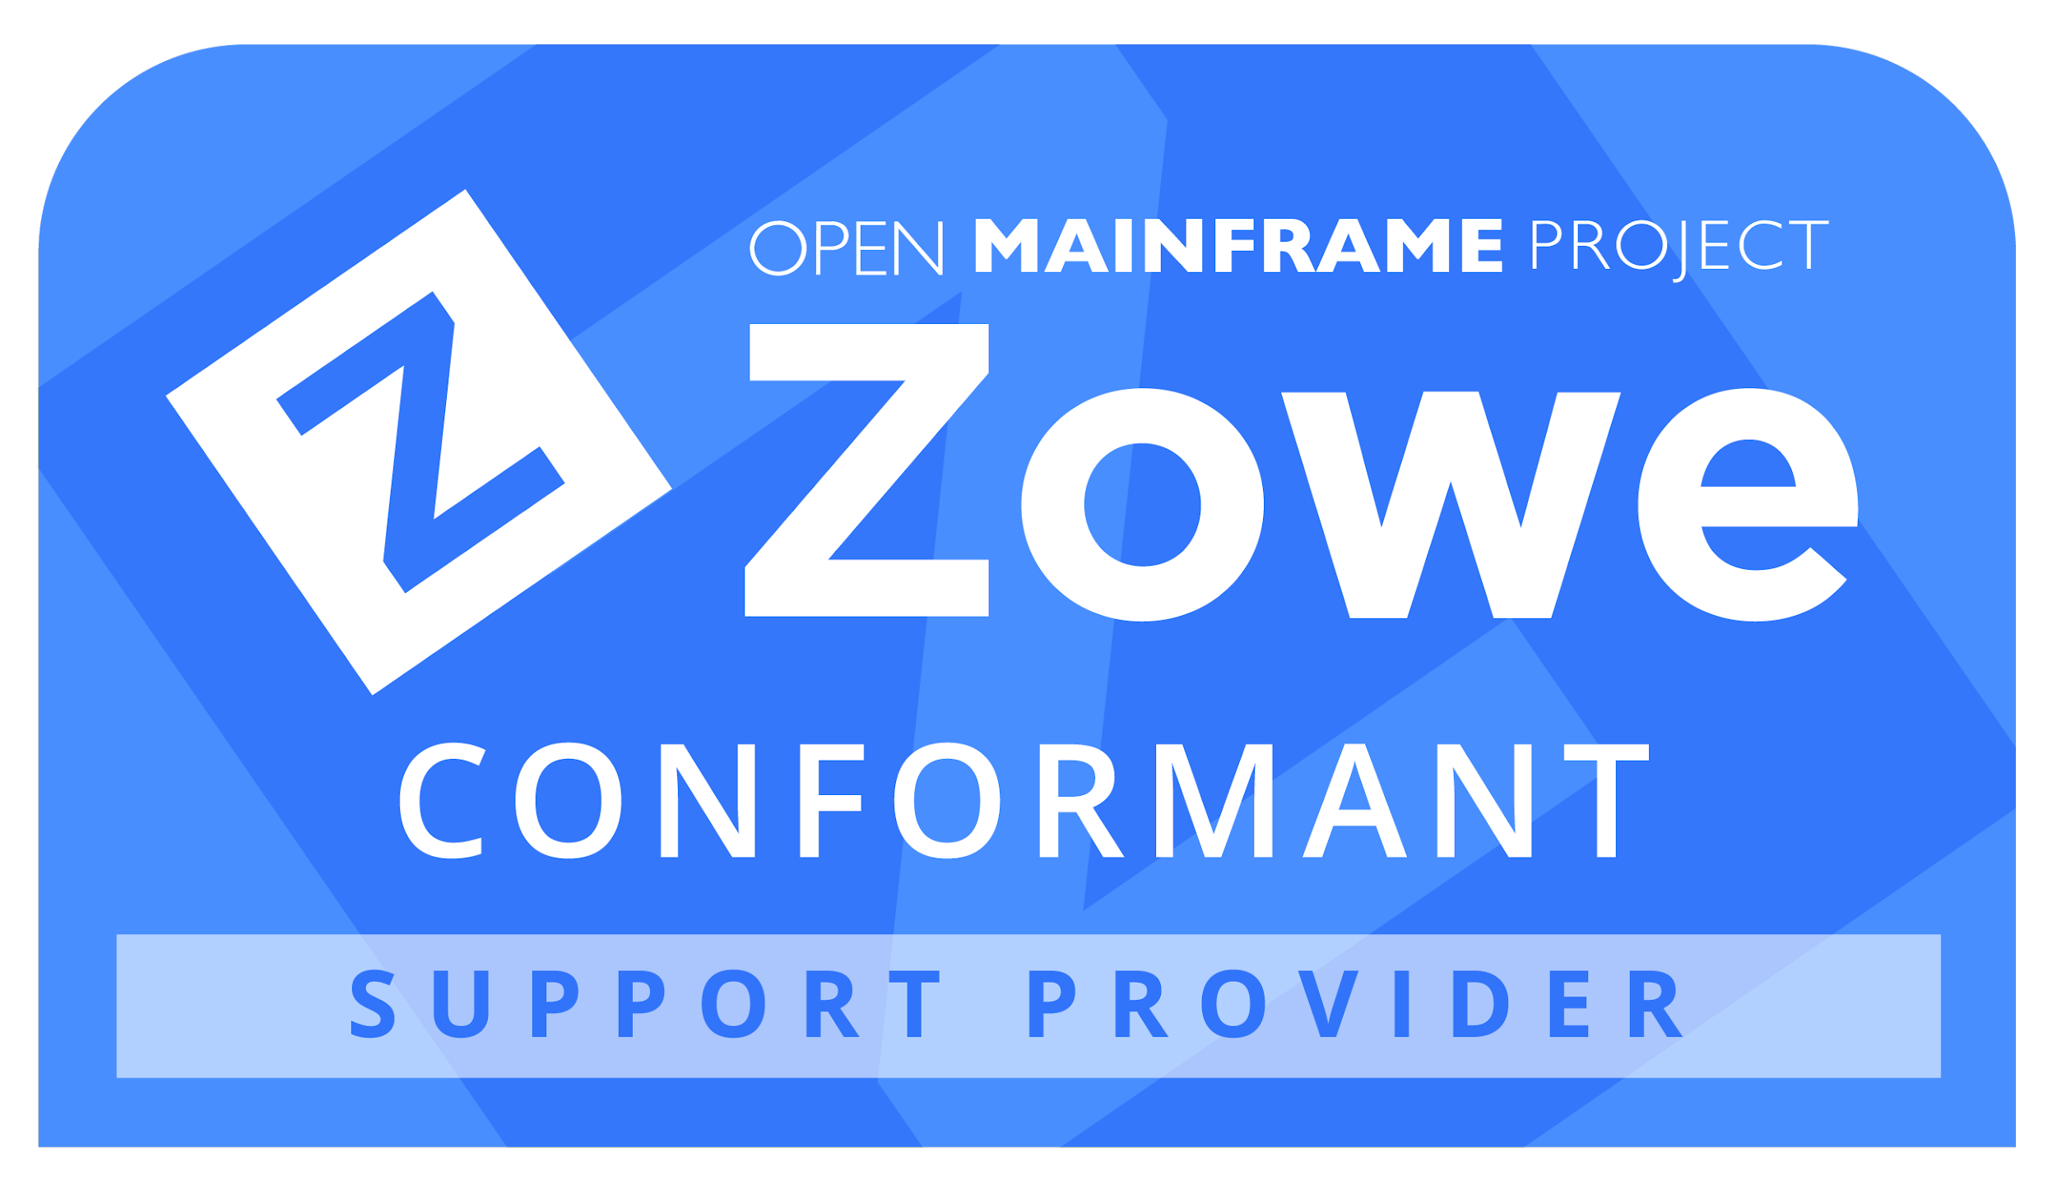
Building an ecosystem through Zowe Conformance
Zowe Conformance Program enables vendors to showcase their offerings based on Zowe, as well as their capabilities in supporting Zowe end-users.
Zowe Support Provider Conformance Program gives vendors the ability to showcase their Zowe support competencies.
Benefits
Your offering and logo listed in the Zowe Conformant offering directory or Zowe Conformant Support Provider directory and showcased in Zowe outreach materials
Exclusive branding marks to use in your product materials
Participation in the Zowe Advisory Council (ZAC)
PR announcement for new organizations providing offerings
Post a guest blog post on your offering on the Open Mainframe Project and Zowe blog
Fees are waived for Open Mainframe Project members
More details at https://www.openmainframeproject.org/projects/zowe/conformance

Slide 29
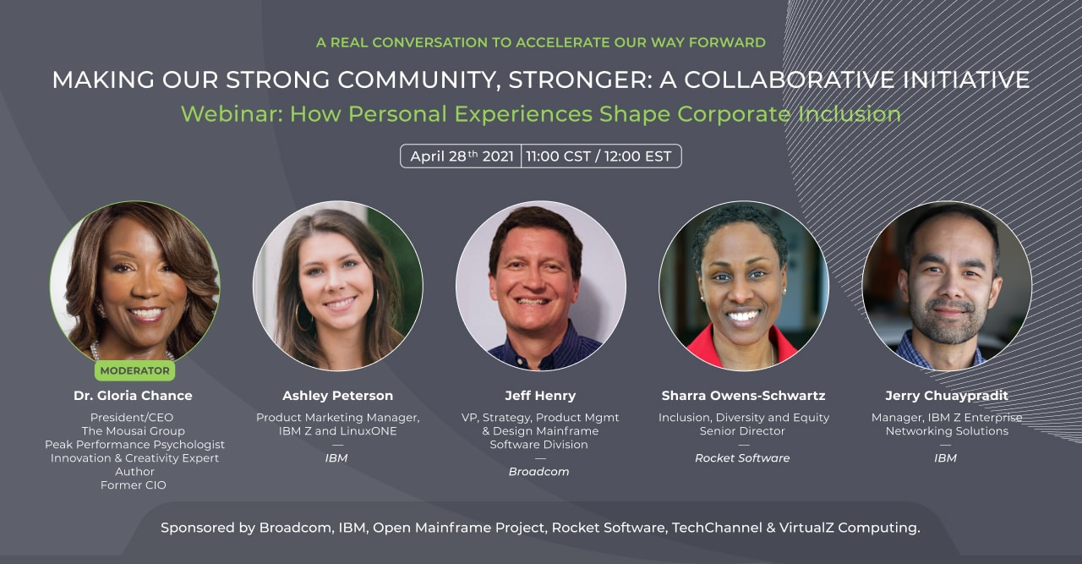
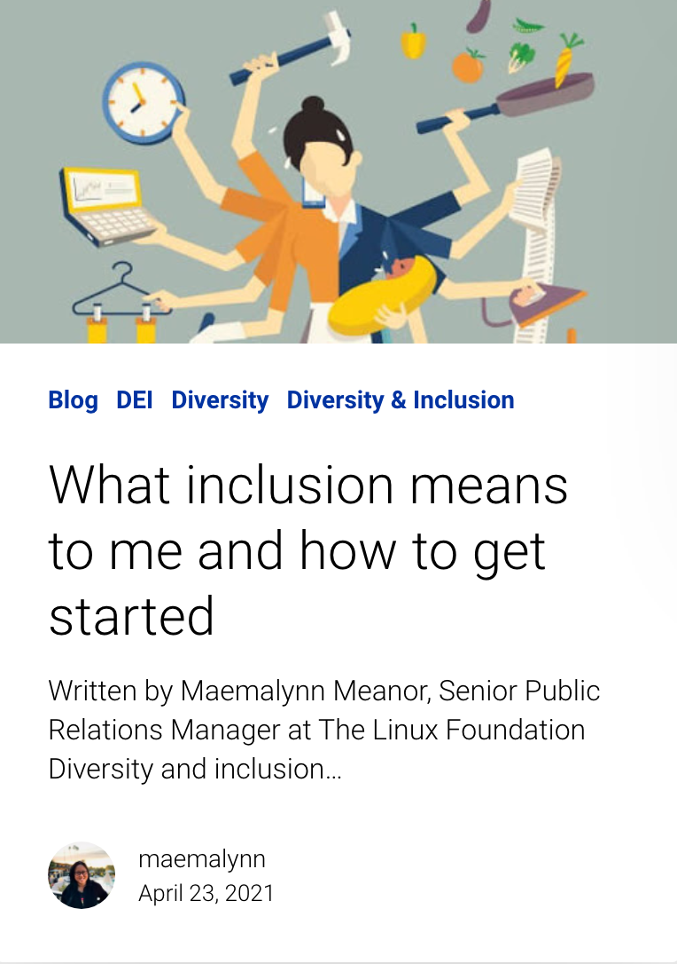
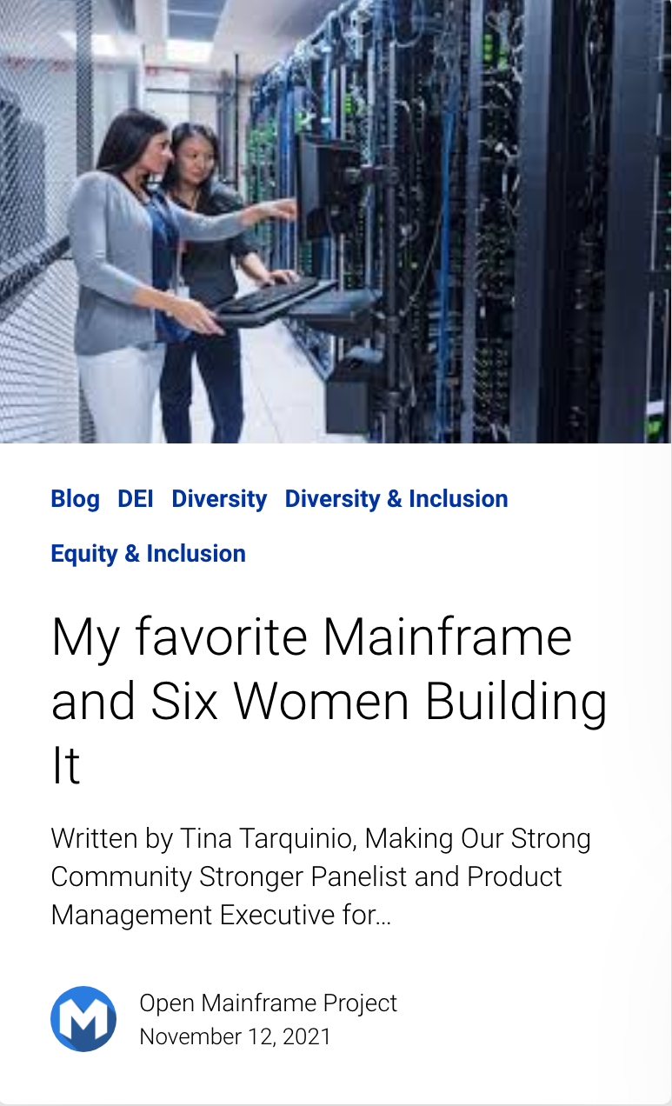
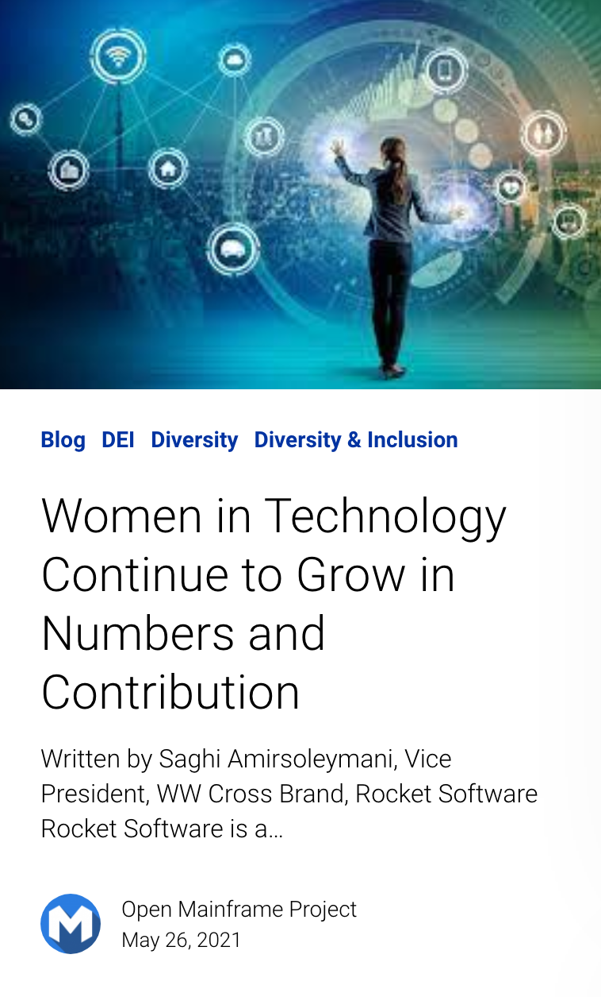
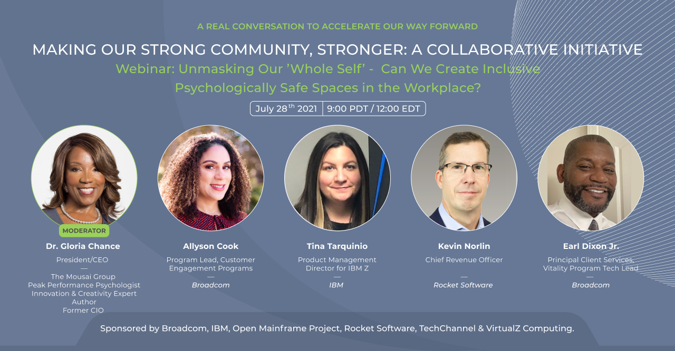
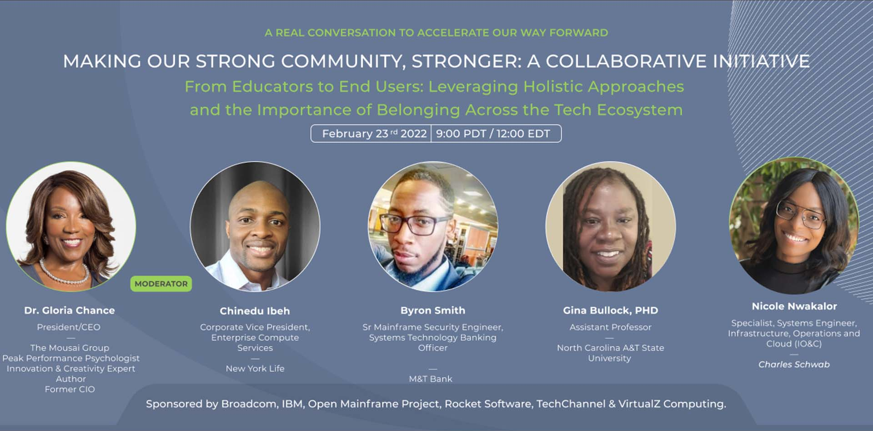
Growing diversity and inclusion in mainframe
Read about diversity in mainframe on Open Mainframe Project’s Blog
Watch the “Making our Strong Community Stronger” series on Open Mainframe Project’s Youtube Channel

Slide 30

Being an example of diversity in leadership in mainframe
Over 35% of Open Mainframe Project Leadership is Female

Slide 31
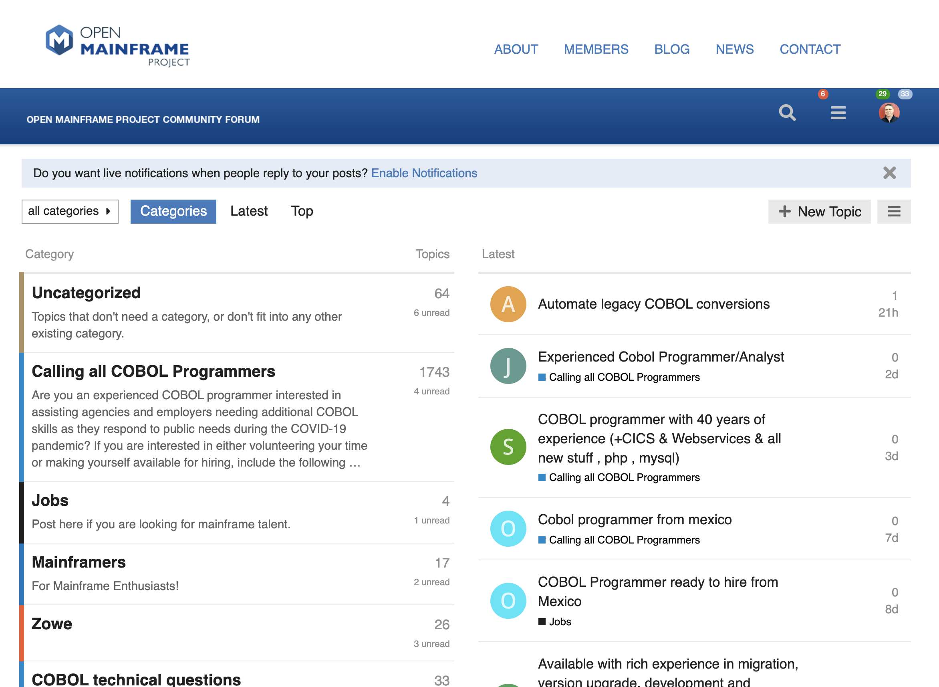
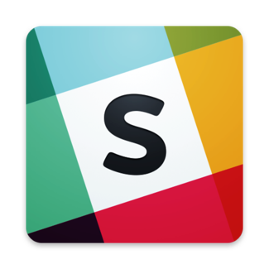
Bringing together the open source and mainframe conversation
Slack Channel
https://slack.openmainframeproject.org
Community Forums
https://community.openmainframeproject.org/
Notes:
Open Mainframe Projects hosts community collaboration platforms, is a part of key industry events, and hosts the annual Open Mainframe Summit to bring together the open source on mainframe community.

Slide 32
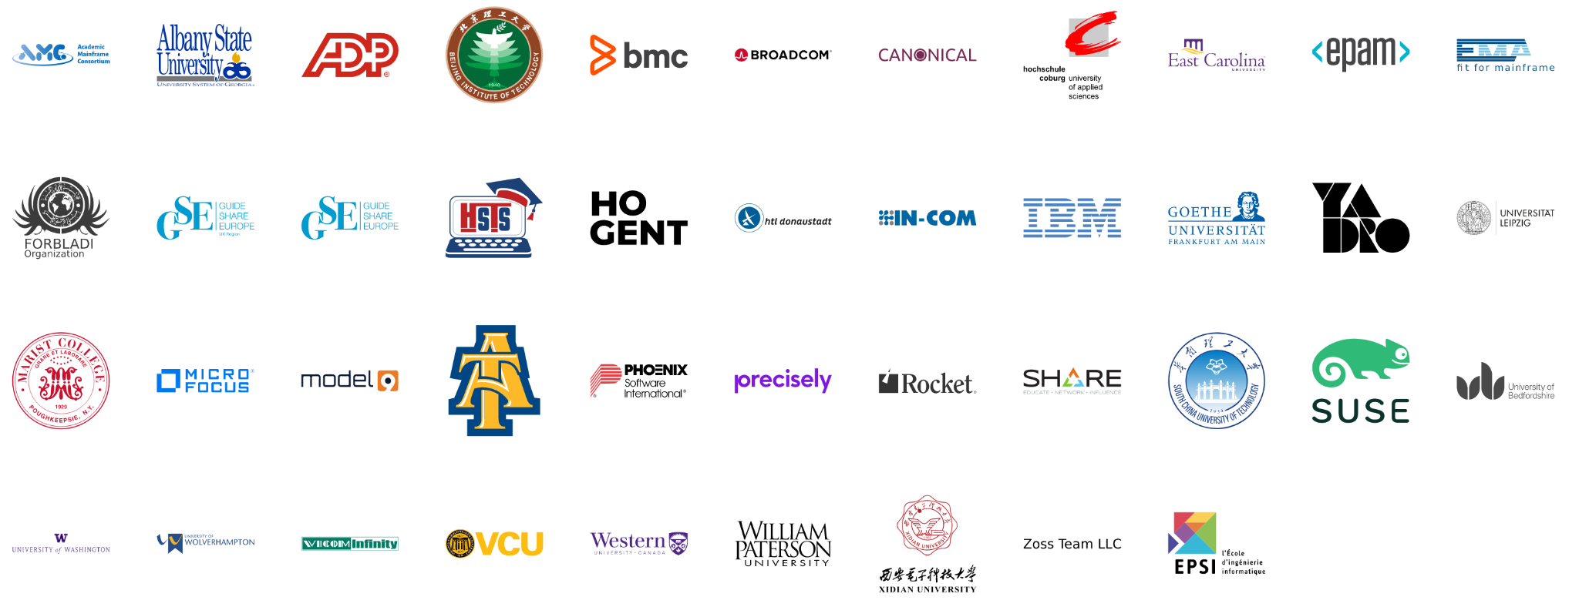
7 years since launch | 43 Supporting Organizations | 20 Hosted Projects and Working Groups | 70+ Mentees Sponsored | 1000+ Project Contributors | 61,000+ Project Contributions
Notes:
In over 5 years, the project has seen tremendous growth by tripling members since launch and growing from 1 project to 18, making huge impacts on the open source on mainframe ecosystem.
Source: https://landscape.openmainframeproject.org/pages/members-non-grouped

Slide 33

How to contribute to projects
Contribute to an existing project:
Submit a PR with a bugfix or new feature
Pick existing GitHub issue as a sample project
Integrate with a new app / contribute plugin
Help improve project documentation
Submit additional test cases
Join the TSC discussion: dev mailing list, conf calls
Get involved with the TAC or Working Group:
DevOps / CI expertise always useful
Interest / expertise in security especially welcome
Join the TAC discussions: mailing list, conf calls, working groups
More information at tac.openmainframeproject.org/engagement

Slide 34




How to participate in Open Mainframe Project
Open participation for all interested in Mainframe and Open Source
Join the community discussion via communication channels, social, and at events
20 Shared R&D open source projects and working groups - or bring your project to be hosted here
Corporate sponsorship for showing stewardship in the community
https://www.openmainframeproject.org/about/join
‹#›
Notes:
Anyone may participate; the Open Mainframe Project encourages companies to become sponsoring participants and support the mission of the Open Mainframe Project.

Slide 35
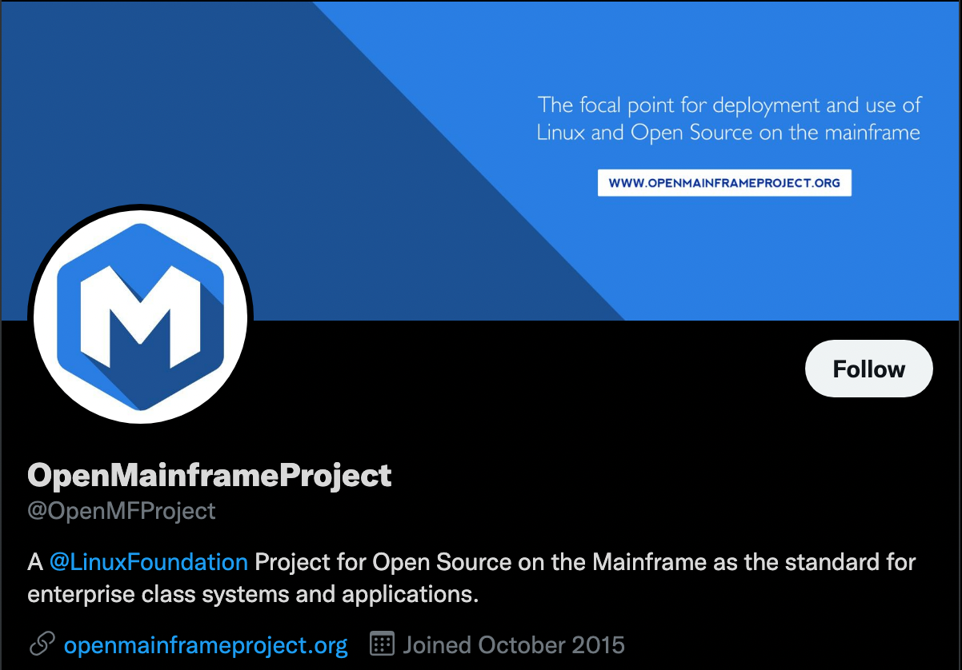
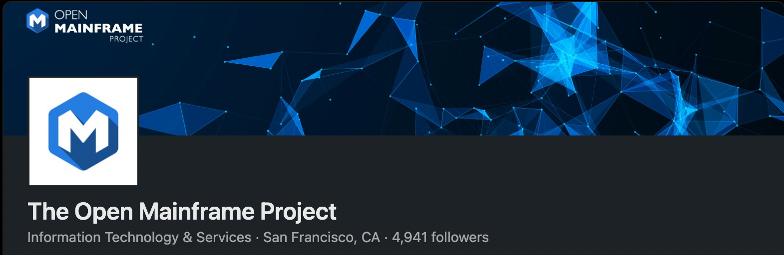
Make sure you are following us on social!
Follow us on LinkedIn at https://www.linkedin.com/company/the-open-mainframe-project
Follow us on Twitter at https://twitter.com/OpenMFProject
And sign up for the Open Mainframe Project newsletter to keep up to date on project happenings

Slide 36


Learn more about the Open Mainframe Project
Find out more at openmainframeproject.org
See the breadth of open source on the mainframe at l.openmainframeproject.org
Discover and participate in any of our 20 hosted projects and working groups at openmainframeproject.org/projects
Take part in our upcoming events and webinars at openmainframeproject.org/events
Notes:
You can get involved and learn more by...

Slide 37
Thank you!

Slide 38
Why become a member?

Slide 39
Becoming an Open Mainframe Project member means your organization is...
a leader in the open source on mainframe community
wants to drive the technical vision of open source on mainframe
a thought leader or aims to be a thought leader in open source on mainframe
bringing solutions to market based on projects hosted at the Open Mainframe Project, and wanting to show your stewardship towards those communities

Slide 40


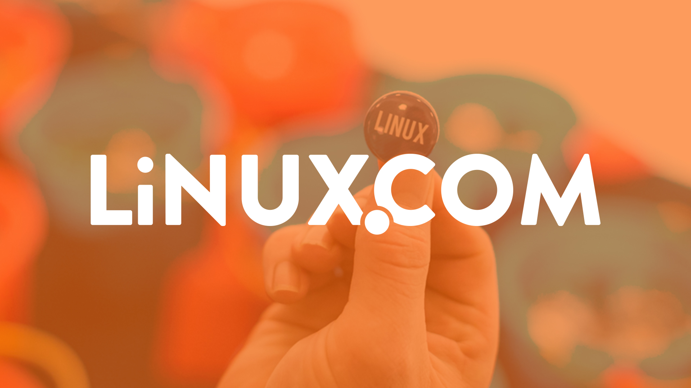





Leverage our industry presence to advance your thought leadership.
Through our large audience, extensive media outreach, and with key partnership with publications such as Linux.com, TFiR, TechChannel, and MediaOps, you will be positioned to be a thought leader in open source. Specific benefits include…
Announcement of your membership via press release and social.
Your company logo on both the Open Mainframe Project website and Linux Foundation website.
Guest blog post(s) on the Open Mainframe Project blog on a thought-leadership topics of our choice.
Provide a guest for the “I Am A Mainframer” podcast, hosted by Steven Dickens and Open Mainframe Project
Post one technical article about an open source project you care about to Linux.com, which has over 1 million unique visitors per month.
Support of your announcements with social outreach and quotes from Linux Foundation and/or Open Mainframe Project leadership as appropriate.
Access to opportunities for contributed articles, videos, podcasts, and events
5000+
followers
3000+
followers
1100+ global media articles in 2021 from 5 press announcements

Slide 41
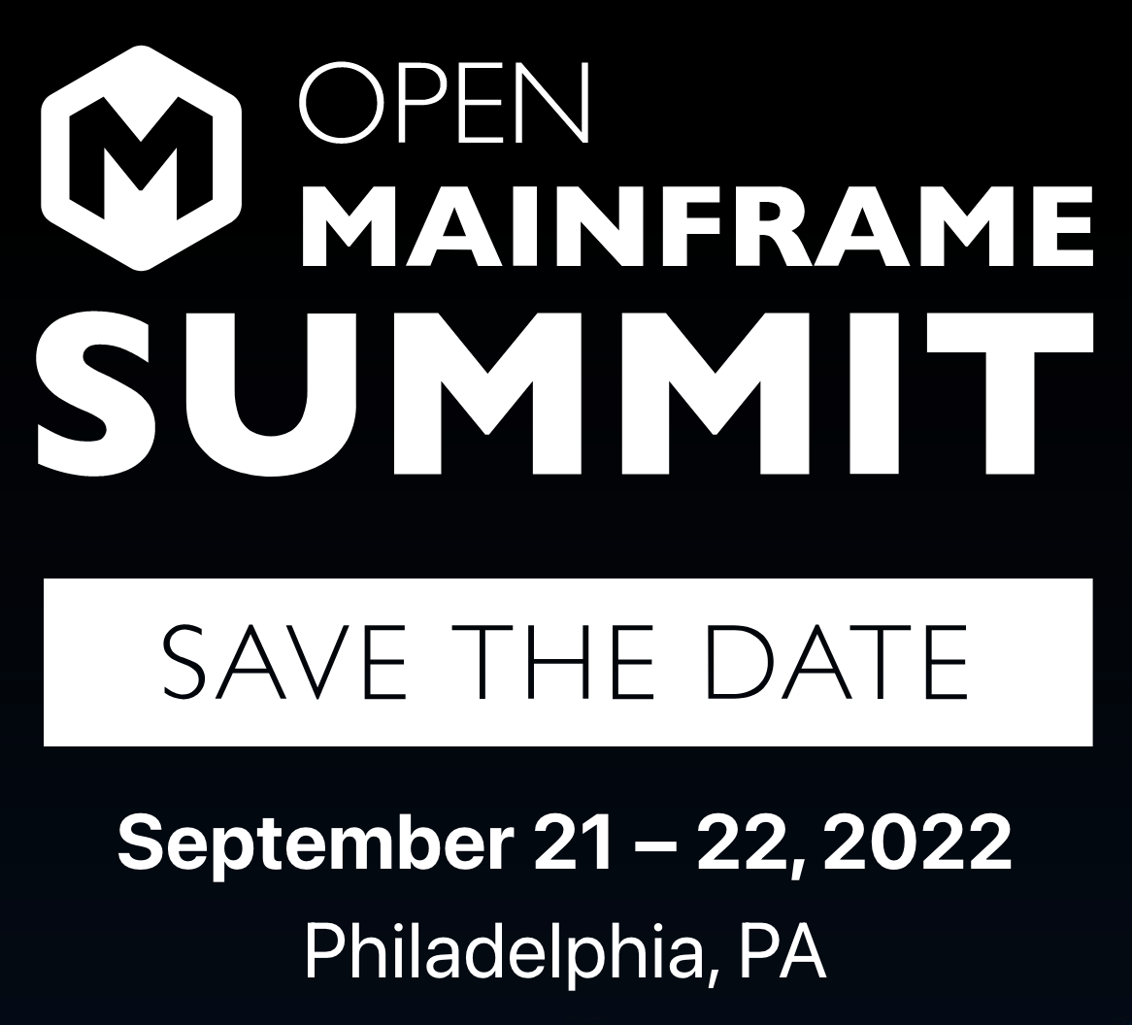
Member exclusive opportunities for
Open Mainframe Summit
Members have an exclusive opportunity to participate in our annual Open Mainframe Summit, this year in person in Philadelphia. This event is the focal point for the open source and mainframe community, bringing together developers, users, and executives, from the mainframe community and beyond.
Member benefits include…
Discounts on registration and sponsorship
Include your news relating to open source on mainframe with our press materials to reach the 20+ reporters and analysts covering the event.
Onsite meetings with Open Mainframe Project leadership

Slide 42
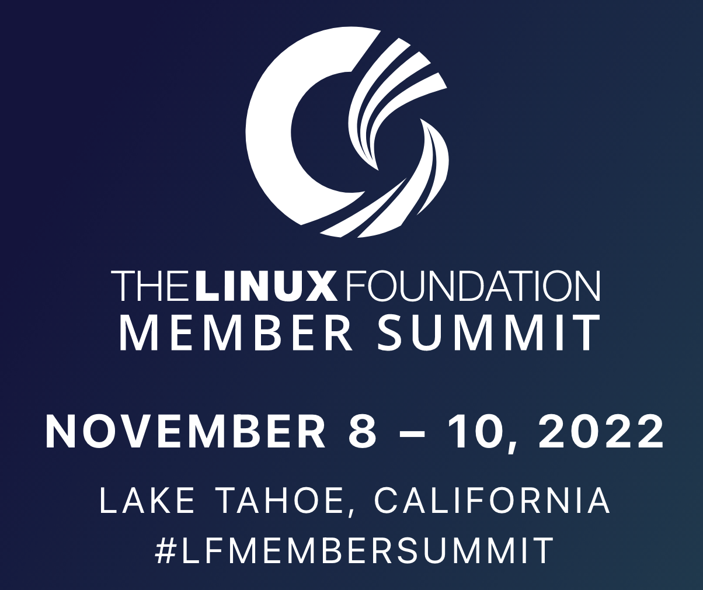
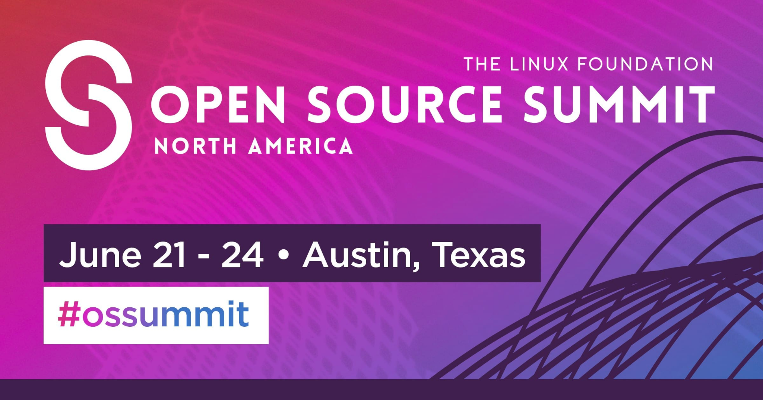
Additional Event Participation Opportunities
One invite to our member-exclusive Linux Foundation Member Summit, which fosters collaboration, innovation, and partnerships among the leading projects and organizations working to drive digital transformation with open source technologies.
Employees at your organization receive a 20% registration discount to eligible Linux Foundation events, such as our Open Source Summit events in North America, Latin America, Europe, and Japan.
Open Mainframe Project hosts mini-events for members and the community at these events.
A 5% Discount on Linux Foundation Event Sponsorship, including Open Mainframe Summit (7% discount on multi-event Sponsorships). Sponsorships offer a valuable way to reach the community of Open Source Developers, Engineers, C-level Executives, and more.

Slide 43
Join the Zowe Conformance Program
Zowe Conformance Program enables vendors to showcase their offerings based on Zowe, as well as their capabilities in supporting Zowe end-users.
Zowe Support Provider Conformance Program gives vendors the ability to showcase their Zowe support competencies.
Benefits
Your offering and logo listed in the Zowe Conformant offering directory or Zowe Conformant Support Provider directory and showcased in Zowe outreach materials
Exclusive branding marks to use in your product materials
Participation in the Zowe Advisory Council (ZAC)
PR announcement for new organizations providing offerings
Post a guest blog post on your offering on the Open Mainframe Project and Zowe blog
Fees are waived for Open Mainframe Project members
More details at https://www.openmainframeproject.org/projects/zowe/conformance

Slide 44
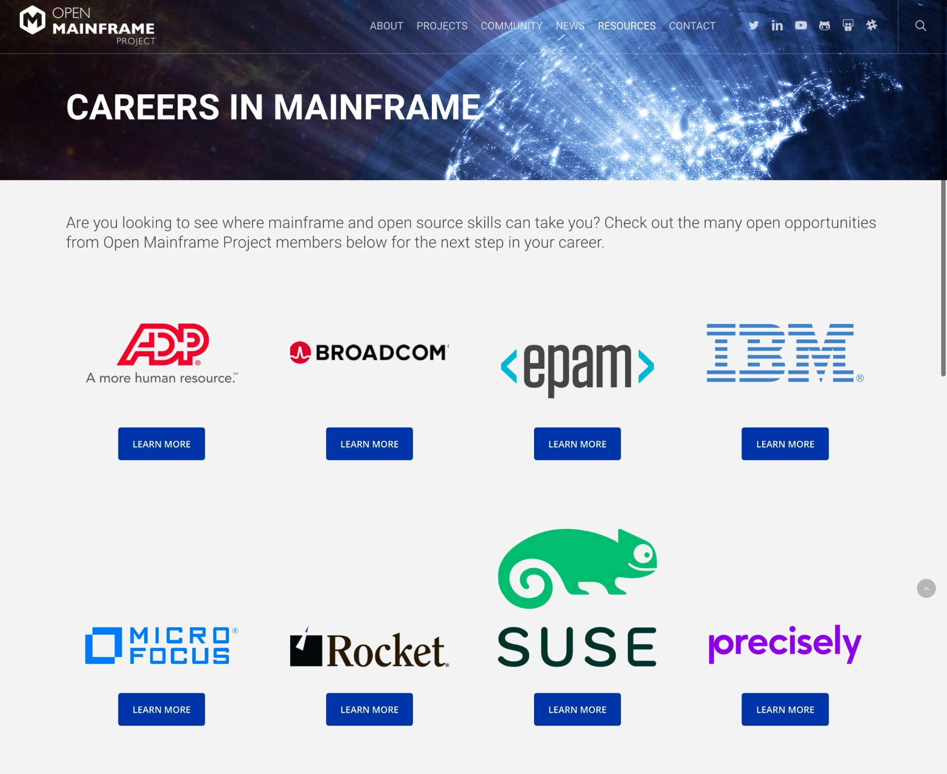
Showcase your career opportunities in mainframe
Showcase of Open Mainframe Project members who are hiring for mainframe positions
Not a job board - links to each member’s job listings
ACTION: Provide a link to your job listings specific to mainframe positions
https://www.openmainframeproject.org/resources/careers

Slide 45

Host a mentorship
Open Mainframe Project funds mentorships for students to bring new talent into mainframe through contributions to open source. These mentees have made huge impacts on hosted projects such as Zowe, Feilong, COBOL Programming Course, and more, as well as broad open source projects such as Alpine Linux, CloudFoundry, Kubernetes, and more.
Members can provide a mentorship and be a mentor, which is funded by the Open Mainframe Project. This provides a unique opportunity to find new talent.
Contact mentorship@openmainframeproject.org if you are interested.

Slide 46
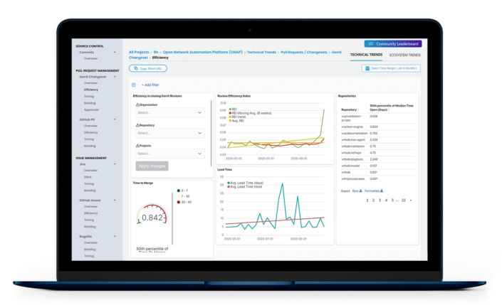

Measure your project impact with LFX Insights
LFX Insights (Technical Trends) is a new analytics tool that is provided to all open source projects hosted by the Linux Foundation. Its capabilities include:
Getting the visibility you need to remove bottlenecks at any stage of your project’s code pipeline. Drill down into performance metrics across every step in the development lifecycle to identify where you should be focusing your resources.
Ensuring the health and viability of the open source projects you care about. Leverage data to help validate projects for investment, and track the activity and growth of projects your organization is already involved in.
Showcasing your organization’s leadership and subject matter expertise in the open source community. Leverage affiliations to measure the impact of your employees’ contributions and capture the full picture of your team’s impact
In addition to the use of the other LFX tools provided by the Linux Foundation, access to LFX Insights (Ecosystem Trends) tool is available to Open Mainframe Project Silver and Platinum members, which provides additional visibility into tracking your project’s performance beyond code with a more holistic view of your ecosystem. Identify opportunities to grow your community and increase awareness with ecosystem trend metrics including share of voice, top influencers, email list collaborators, and more.

Slide 47

Maximize Your Open Source Investment with training
The Linux Foundation offers training and certification direct from the source, those contributing to the world’s most important open source projects.
As an Open Mainframe Project Silver or Platinum member, you are entitled to 10 vouchers for 100% any…
LF eLearning Class
Certification Exam
eLearning+Certification Exam “Bundle".
The value is $299+ per course.

Slide 48
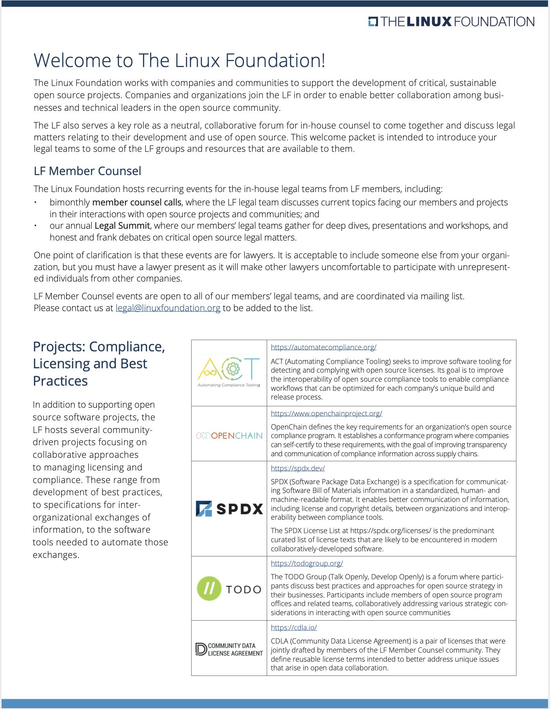
Improve your open source compliance and practices
As a Linux Foundation member, your in-house counsel has access to the leading vendor-neutral resources in open source compliance, best practices, and training, along with peer collaboration. Specific benefits include…
Your legal counsel’s ability to participate in bi-monthly legal calls
One invite for your in-house counsel to LF Legal Summit, which helps connect your counsel to their peers at other member companies and advance your organization’s open source licensing, litigation, compliance, and best practices.
Access to a complimentary membership to the TODO Group, which is a forum for discussing best practices and approaches for establishing and managing open source program offices in organizations.
Support from the vast expertise in the Linux Foundation in engaging with open source, and even starting your own open source project(s).

Slide 49
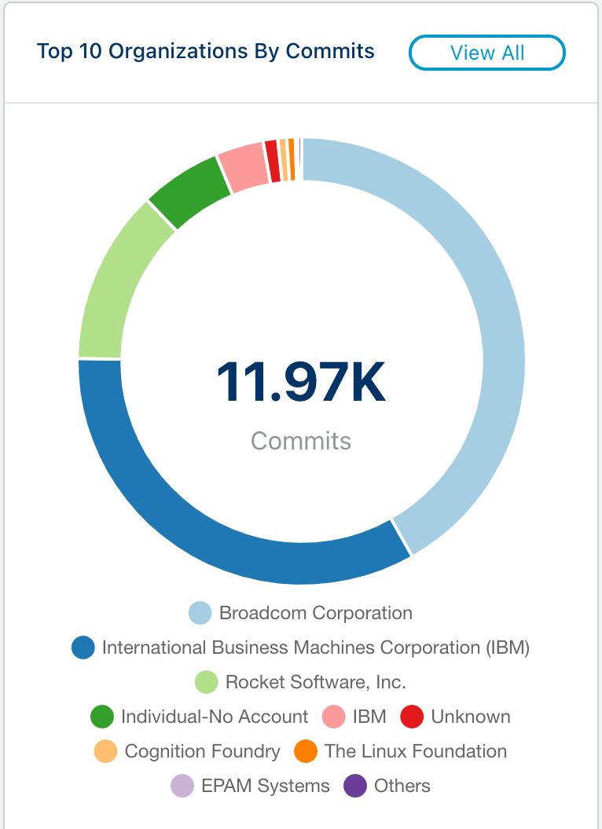
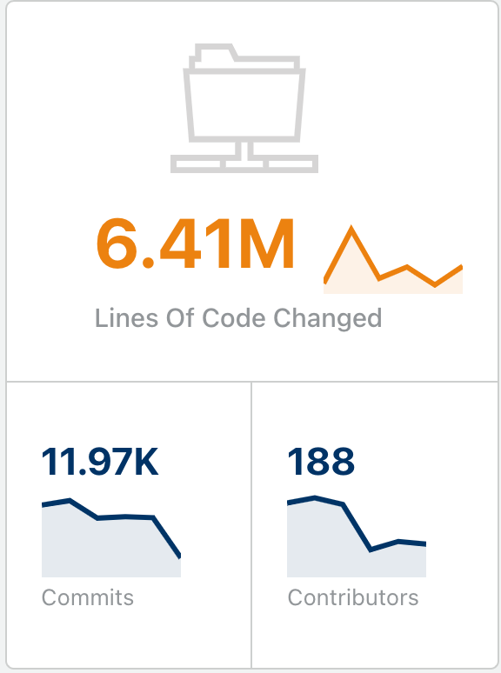
But most importantly, you support innovation
21 collaborative projects and working groups are successful because of the investment of members funding these initiatives.
Stats for 2020 listed at left

Slide 50
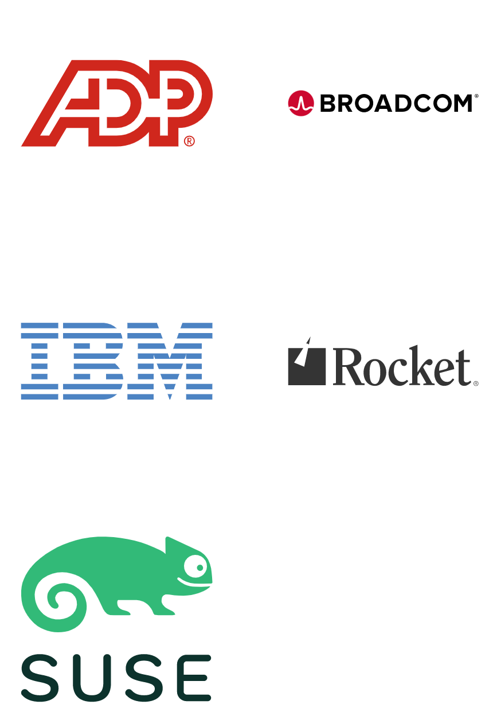
Drive the direction of the foundation through Platinum Membership
Platinum members are the key stewards of the Open Mainframe Project, and as such hold key leadership positions in the various governance structures. Their investment is key to the sustainability of open source in mainframe.
Specific Benefits include:
Voting seat on the Governing Board, TAC, and Marketing Committee, enabling the member to direct the strategic direction, budget, and priorities of the Open Mainframe Project.
Host an Open Mainframe Project webinar and have a guest on the “I Am A Mainframer” podcast annually, if desired.
Regular meetings to brief on project activities, and an annual membership check-in to review engagement opportunities and provide feedback to project leadership.
First opportunity to participate and drive event and outreach opportunities, and the project will ensure partnership with Platinum Members in relevant events.
Open Mainframe Project leadership will support Platinum Member events, internal open source program efforts, and be available for customer and prospect engagement.
Additional training benefits through LF Training.

Slide 51
Corporate, Academic, Associate Membership Levels
Level | Annual Fee Includes LF Silver Membership | Board Seat | TAC Seat | Marketing Committee | Notes
Platinum | $120,000 | Yes | Voting | Yes | Initial 2-year participant commitment
Platinum End-User | $30,000 | Yes | Voting | Yes | Initial 2-year participant commitment
Silver | 5,000 employees or more = $50,000 2,000 < 5,000 employees = $35,000 1,000 < 2,000 employees = $30,000 500 < 1000 employees = $25,000 100 < 500 employees = $15,000 < 100 employees = $10,000 | 1 per 10 | Non Voting | Yes
Academic | Free | 1 per 10 | Non Voting | Yes | Restricted to academic institutions
Associate | Free | No | Non Voting | Yes | Non-profits, open source projects
To join Open Mainframe Project, go to https://www.openmainframeproject.org/about/join or email at membership@openmainframeproject.com
Listed fees include Linux Foundation Silver membership. If you are already a Linux Foundation Member, reduced pricing is available.
‹#›

